Slide 1



MLP IN ACTION | WEBINAR SERIES
USING MLP TO UNDERSTAND AND ADDRESS THE HEALTH-HARMING EFFECTS OF CLIMATE CHANGE
January 11, 2024
1 – 2 PM ET
Notes:
BH (Slides 1 -12)

Slide 2
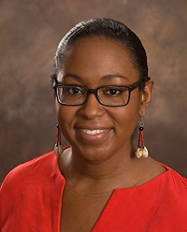
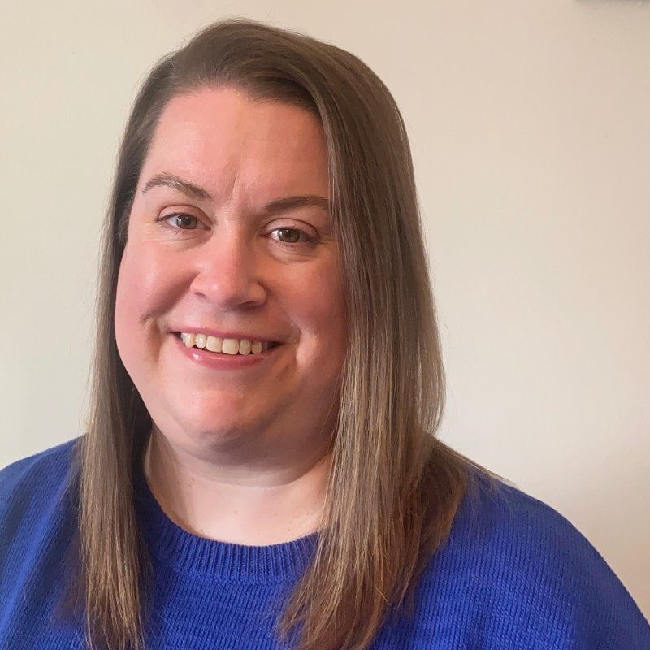
Co-Moderators
Name
Bethany Hamilton, JD
Co-Director
Natinoal Center for Medical-Legal Partnership
Katie Hathaway, JD
Consultant
National Center for Medical-Legal Partnership
Notes:
BH

Slide 3

This project is supported by the Health Resources and Services Administration (HRSA) of the U.S. Department of Health and Human Services (HHS) as part of an award to the National Center for Medical-Legal Partnership totaling $550,000 with 0 percent financed with non-governmental sources. The contents are those of the author(s) and do not necessarily represent the official views of, nor an endorsement by HRSA, HHS, or the U.S. Government. For more information, please visit HRSA.gov.
Notes:
BH

Slide 4


Housekeeping
Attendees are muted throughout the webinar.
Type questions into Questions & Answers pane.
To activate captions, select “Live Transcript” and “Show Subtitle.”
This webinar will be recorded and shared at medical-legalpartnership.org/resources/
Send a chat to the Hosts & Panelists for help.
Notes:
BH

Slide 5
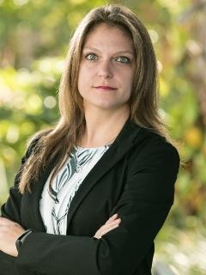
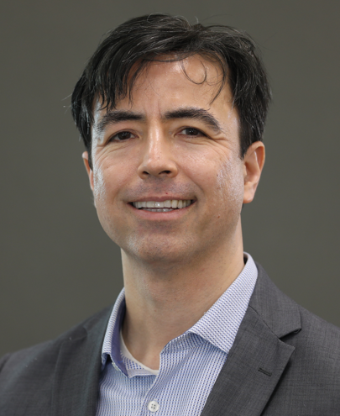
Subject Matter Experts:
Christina Russo Walters
Senior Managing Attorney
Medical-Legal Partnerships
Community Legal Services Mid-Florida
Dr. Frederick Anderson
Associate Professor; Medical Director
Florida International University
Mobile Health Center
Notes:
BH

Slide 6
1
Deepen Your Understanding:
Expand your knowledge of how climate change disproportionately affects the health outcomes of low-income and underserved patients and communities.
Learning Objectives
  2
Empower Through Partnership:
Use the medical-legal partnership approach to screen patients for climate-induced social risk factors and work collaboratively with legal professionals to address health-harming legal needs or barriers.
  3
Build Preventative Capacity:
Develop the skills to proactively use MLPs as a preventative measure, effectively mitigating the health-harming effects associated with climate change.
Notes:
BH

Slide 7
The Medical-Legal Partnership Approach
Notes:
BH

Slide 8
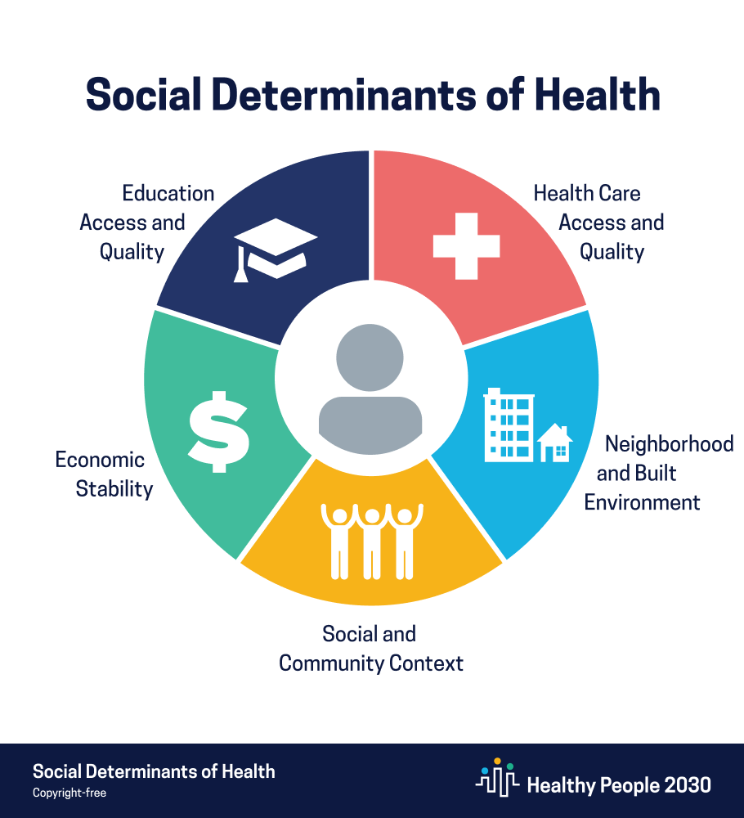
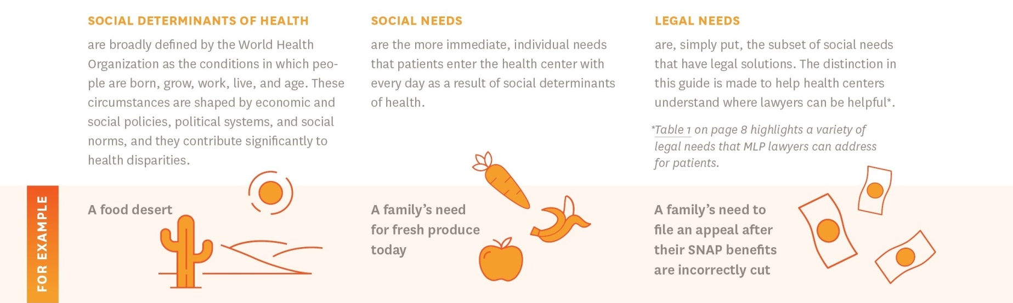
Where do legal services fit within a health center’s response to SDOH?
Healthy People 2030, U.S. Department of Health and Human Services, Office of Disease Prevention and Health Promotion. Retrieved 1/2/24, from https://health.gov/healthypeople/objectives-and-data/social-determinants-health
Notes:
BH

Slide 9
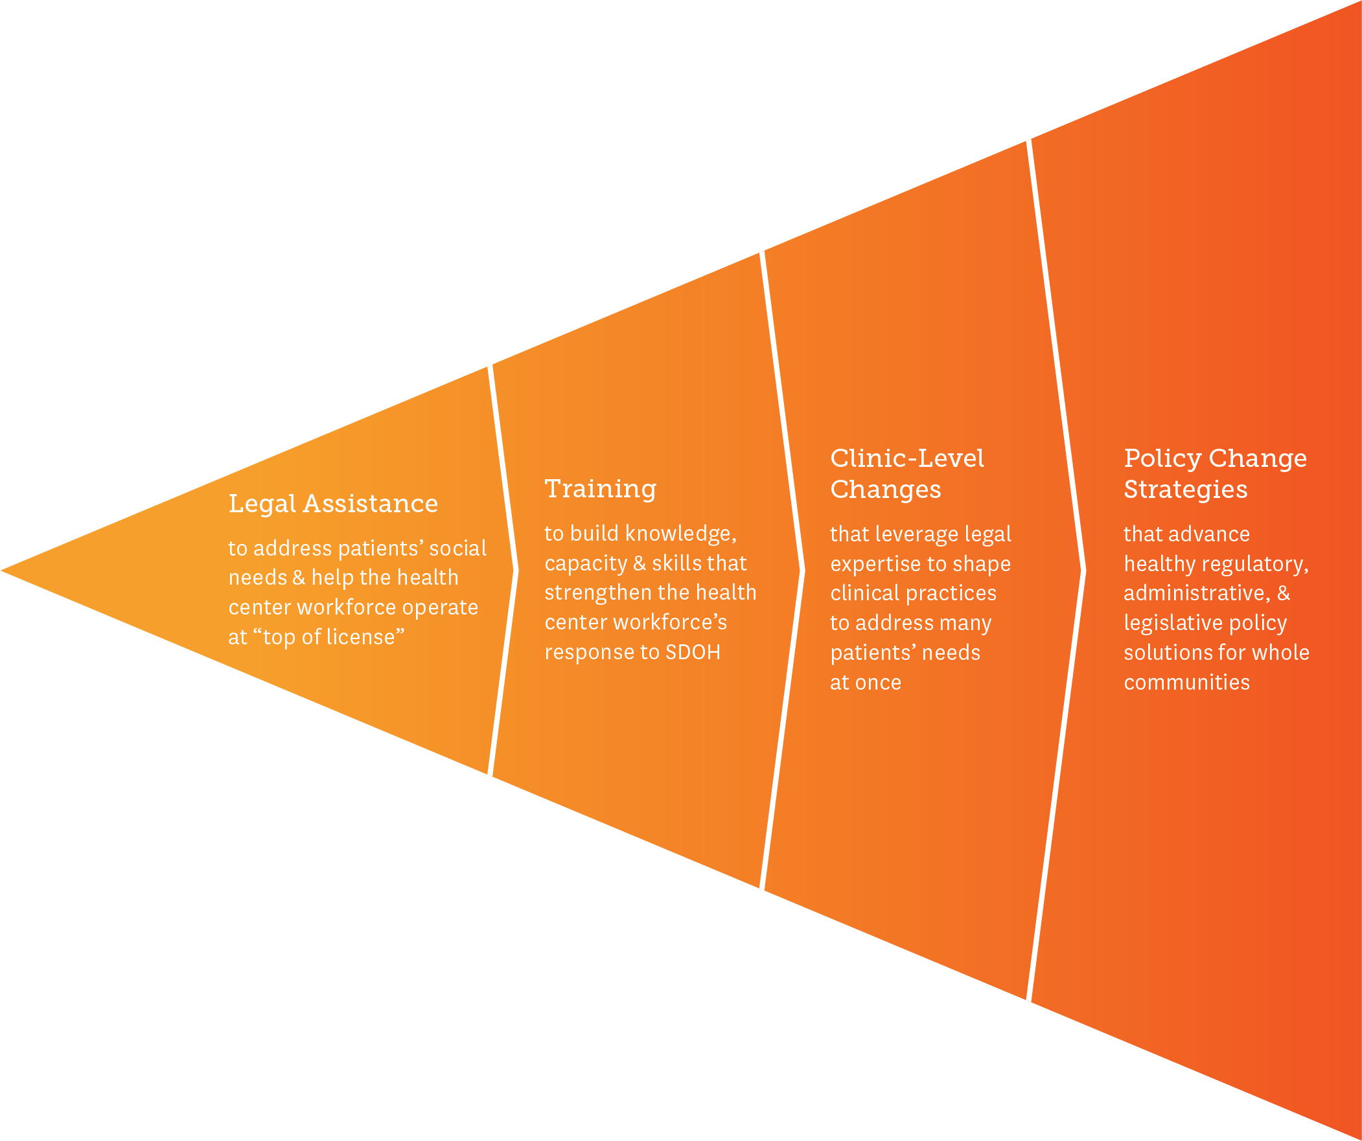
What is the Medical-Legal Partnership (MLP) Approach?
Medical-Legal Partnership (MLP) is an intervention where legal and health care professionals collaborate to help patients resolve social, economic, and environmental factors that contribute to health disparities and have a remedy in civil law.
The MLP approach is a flexible, evidence-based, public health, and social justice intervention designed to meet the needs of the community.
Notes:
Impact of MLP: Team members can address health-related social needs while working at “top of license”
Impact of MLP: One of the only interventions that can identify, address and prevent individual needs AND underlying policies

Slide 10

How Legal Services Help Health Care Address the Social Determinants of Health (I-HELPTM)
Common SDOH | How Legal Services Can Help | Impact of Legal Services on Health / Health Care
INCOME & INSURANCE Resources to meet daily basic needs | Appeal denials of food stamps, health insurance, cash benefits, and disability benefits | Increasing someone’s income means s/he makes fewer trade-offs between affording food and health care, including medications. Being able to afford enough healthy food helps people manage chronic diseases and helps children grow and develop.
HOUSING & UTILITIES A healthy physical environment | Secure housing subsidies Improve substandard conditions Prevent evictions Protect against utility shut-off | A stable, decent, affordable home helps a person avoid costly emergency room visits related to homelessness. Consistent housing, heat and electricity helps people follow their medical treatment plans.
EDUCATION & EMPLOYMENT Quality educational and job opportunities | Secure specialized education services Prevent and remedy employment discrimination Enforce workplace rights | A quality education is the single greatest predictor of a person’s adult health. Consistent employment helps provide money for food and safe housing, which also helps avoid costly emergency health care services. Access to health insurance is often linked to employment.
LEGAL STATUS Access to jobs | Resolve veteran discharge status Clear criminal / credit histories Assist with asylum applications | Clearing a person’s criminal history or helping a veteran change their discharge status helps make consistent employment and access to public benefits possible. Consistent employment provides money for food and safe housing, which helps people avoid costly emergency health care services.
PERSONAL & FAMILY STABILITY Safe homes and social support | Secure restraining orders for domestic violence Secure adoption, custody and guardianship for children | Less violence at home means less need for costly emergency health care services. Stable family relationships significantly reduce stress and allow for better decision-making, including decisions related to health care.
This chart is reprinted from “Framing Legal Care as Health Care,” a messaging guide created by the National Center for Medical-Legal Partnership. Please do not recreate it without permission.
Notes:
BH

Slide 11
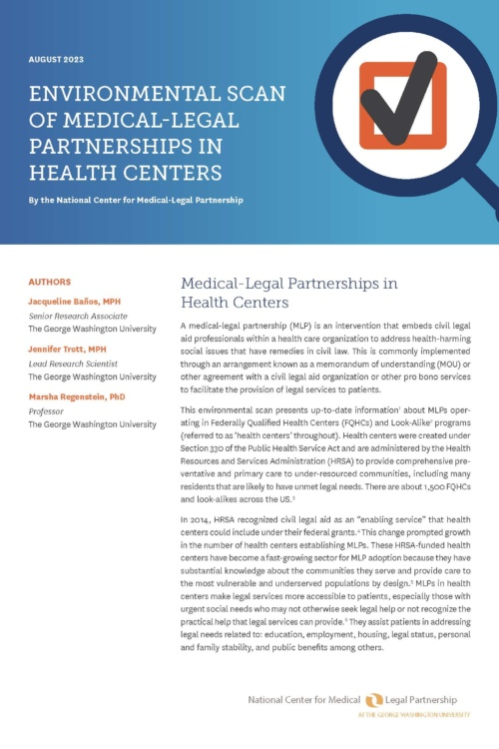
Health Center-Based Medical-Legal Partnerships
Health Center Program began with Section 330 of the Public Health Services Act of 1965, and is administered by HRSA
There are approximately 1,400 health centers across the US operating at over 15,000 sites
In 2022, health centers served over 31.5 million patients including:
1 in 3 uninsured people
1 in 3 people living in poverty
1 in 7 rural residents
Health centers provide community-based, patient-directed, comprehensive, and high-quality primary care and preventive services
Health centers also provide enabling services that facilitate access to care. Since 2014, enabling services have include “civil legal aid services” as an example of eligibility assistance and additional enabling/supportive services.
Approximately 150-200 health centers operate MLPs to embed lawyers in the health center’s health care team to help treat patients’ immediate social needs and deploy upstream strategies to address the social determinants of health.
NCMLP Report: Environmental Scan of Medical-Legal Partnerships in Health Centers
Notes:
BH

Slide 12
Using MLP to Understand and Address the Health-Harming Effects of Climate Change
Notes:
BH

Slide 13
Christina Russo Walters
Senior Managing Attorney
Medical-Legal Partnerships
Community Legal Services Mid-Florida
Notes:
BH

Slide 14
Dr. Frederick Anderson
Associate Professor; Medical Director
Florida International University
Mobile Health Center
Notes:
BH

Slide 15


Poll Question
Please tell us about yourself.
Are you a:
Healthcare provider/worker?
Legal advocate/lawyer?
Other (please feel free to let us know in the chat)
Notes:
CRW and FA

Slide 16
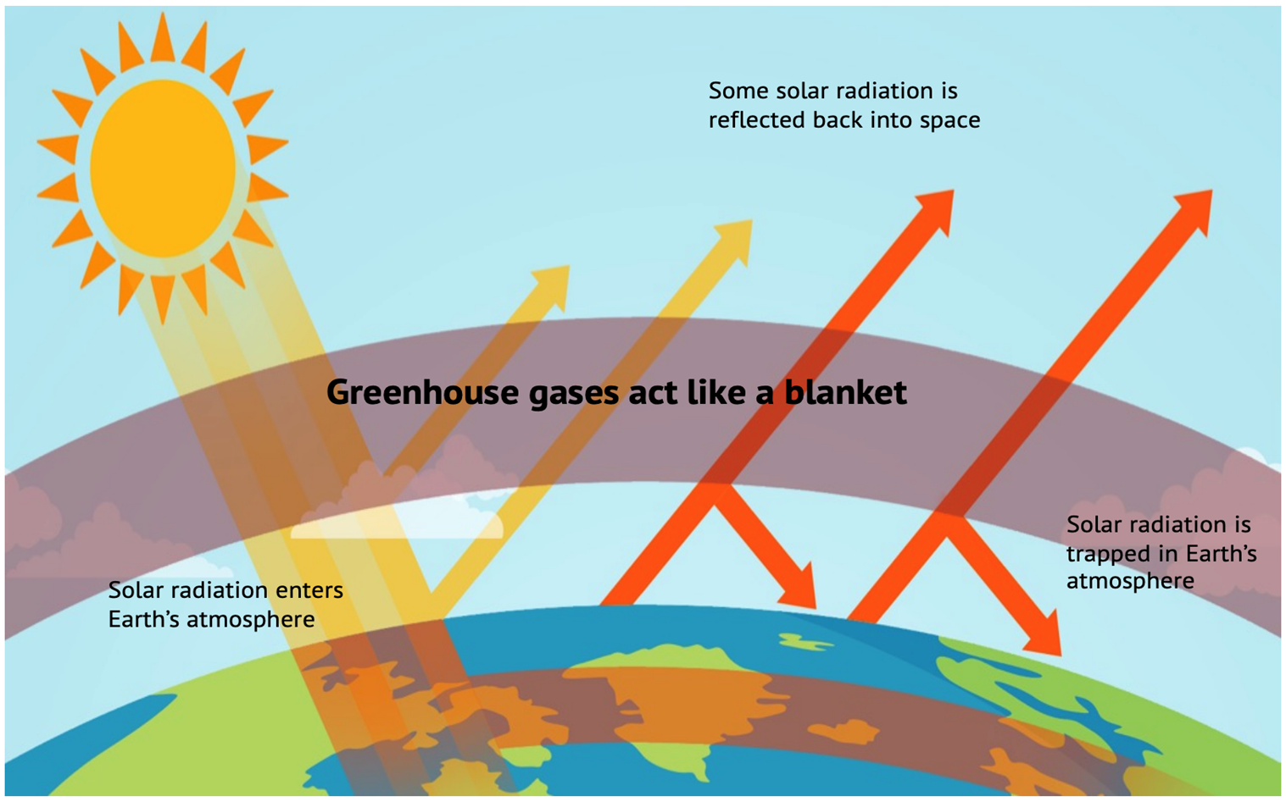
What is Climate Change?
Text
Centers for Disease Control and Prevention

Slide 17
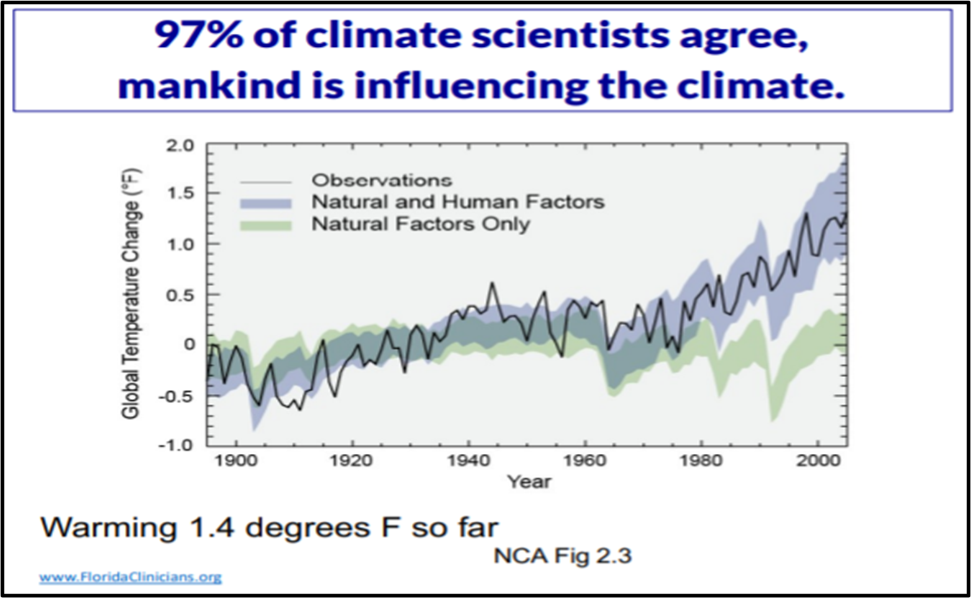

C

Slide 18
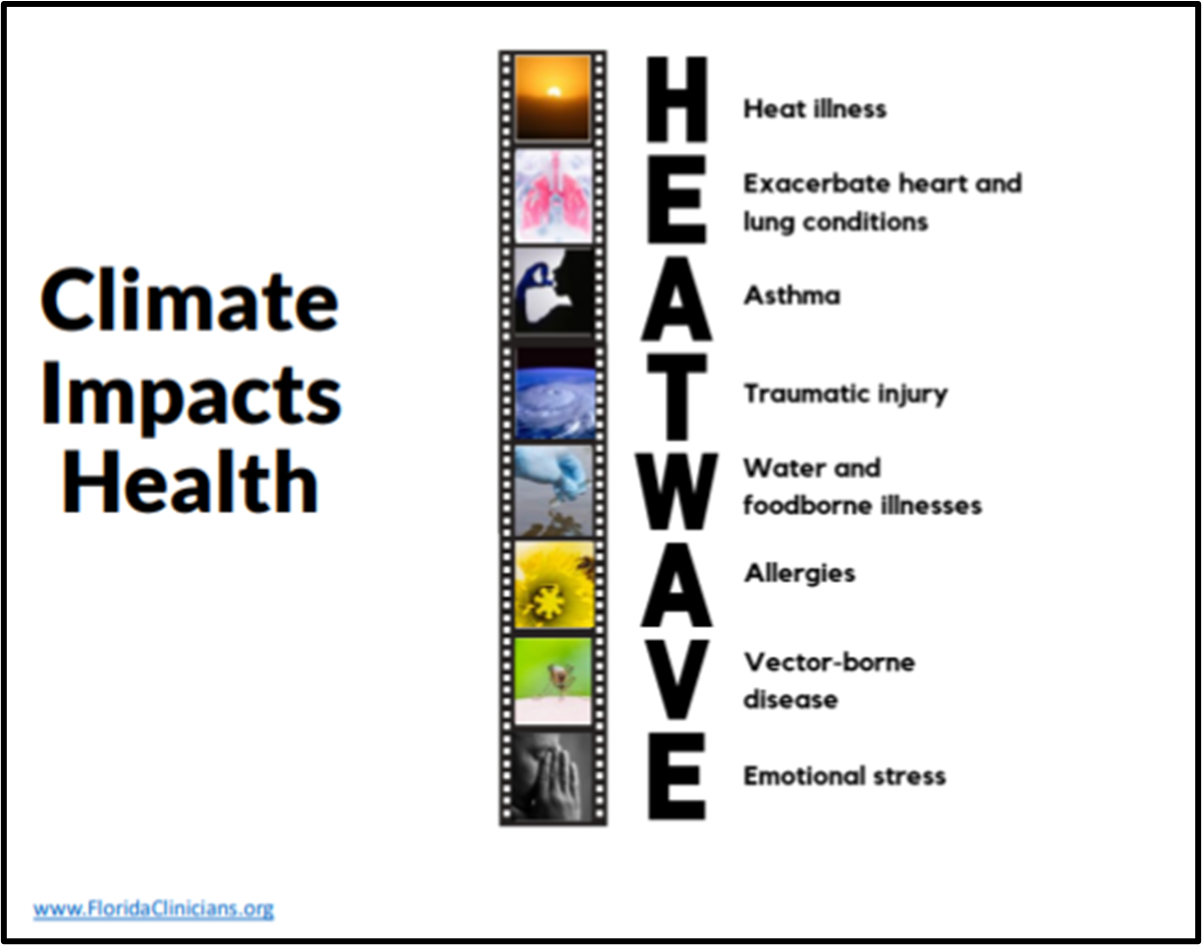

Slide 19
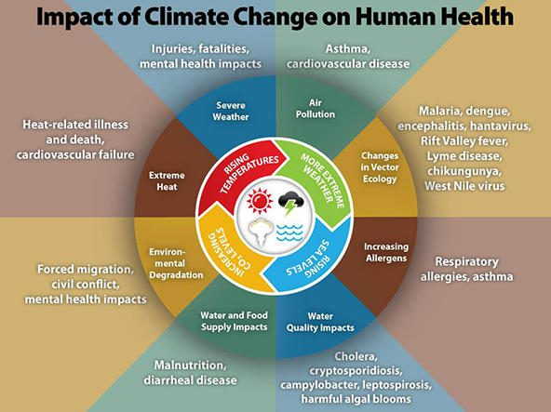
Asthma and Allergy Foundation of America
https://aafa.org/advocacy/key-issues/climate-and-health/

Slide 20
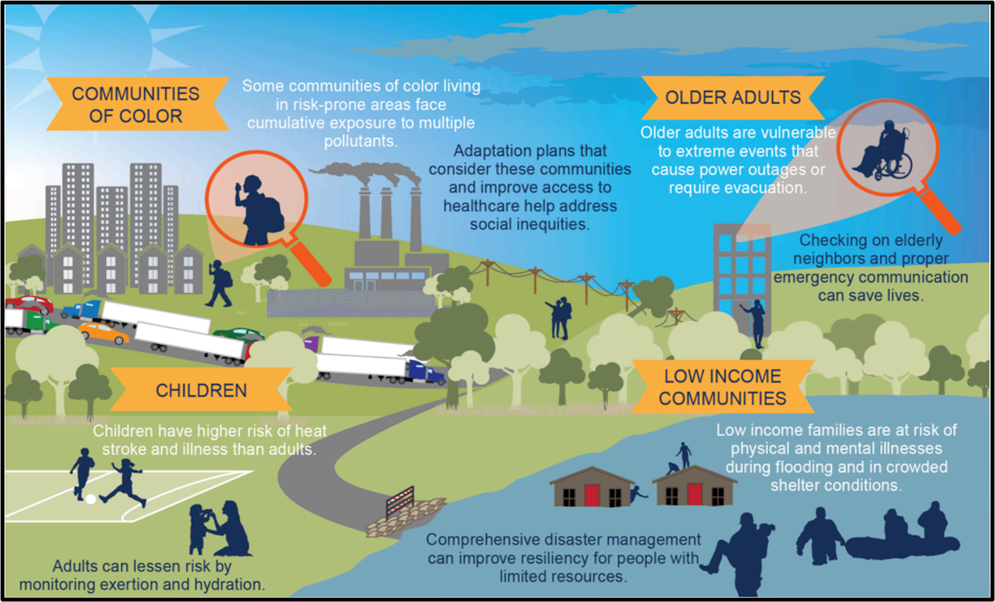
Vulnerable Populations
EPA (National Climate Assessment)

Slide 21

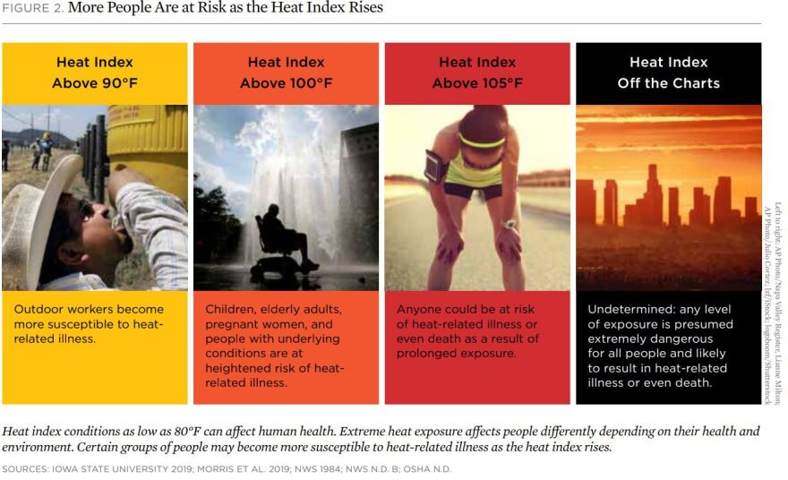
Killer Heat
In Florida, there is a historical average of 25 days per year with a heat index “feels like” temperature above 100 degrees Fahrenheit.
This would increase to 105 days per year on average by midcentury (2036-2065) and 141 by the century’s end.

Slide 22
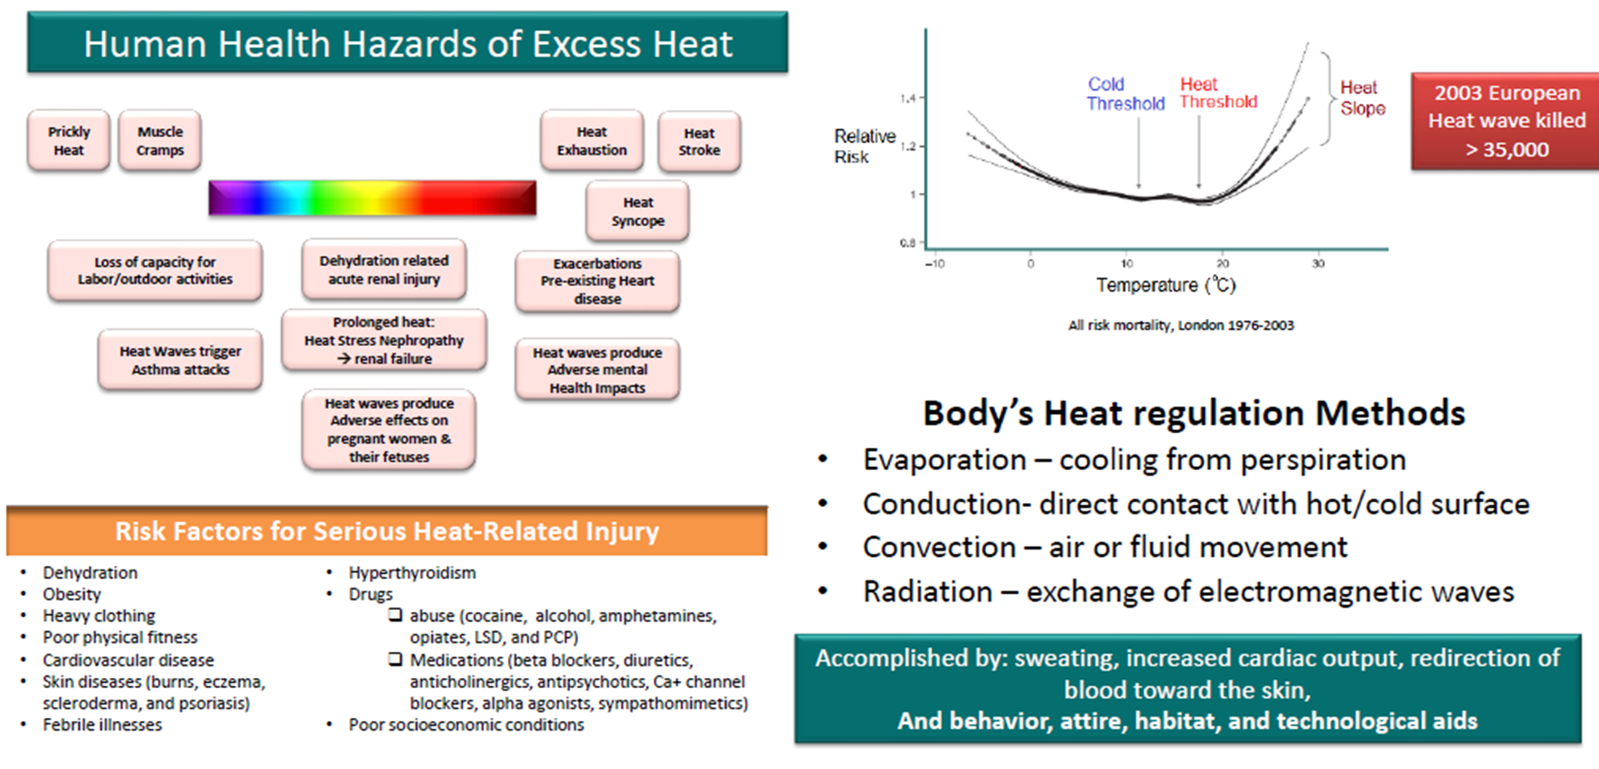
Courtesy of Dr. Aileen Marty, FIU

Slide 23
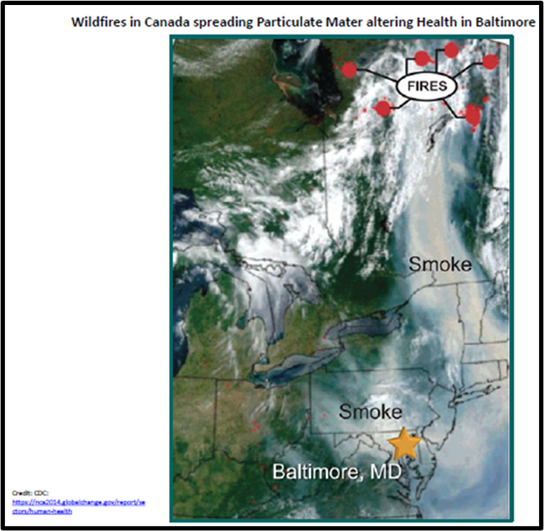
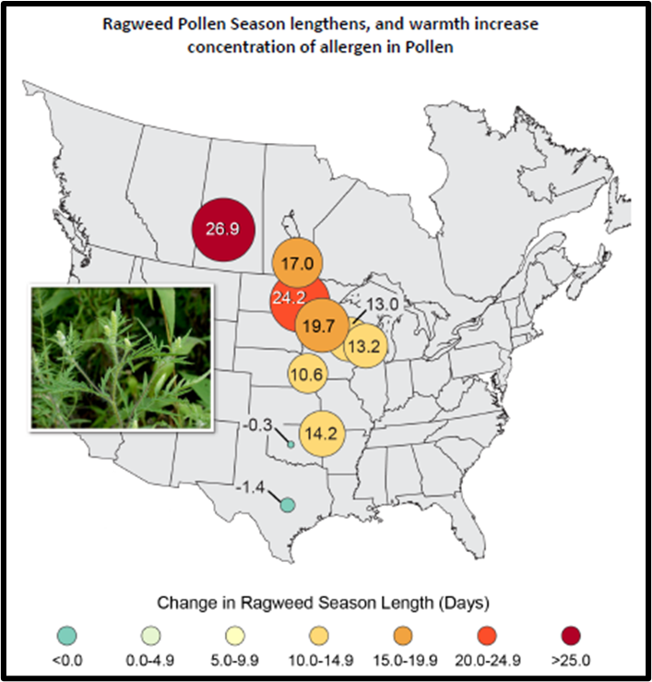
Worsened Air Quality/Allergens
Excess Moisture/Flooding and Severe Droughts in other areas.
Wildfires - Air Pollution
Impact on respiratory illnesses
Warmer temps - Longer Pollen Season
Courtesy of Dr. Aileen Marty, FIU

Slide 24



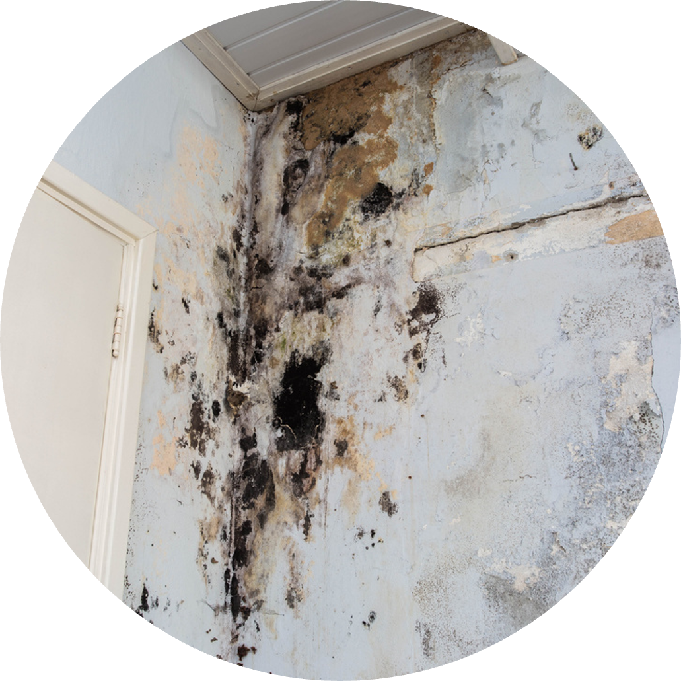

Some ways in which Climate Change impacts Respiratory Illness
HEAT
POLLEN
SMOKE
MOLD
SMOG
Heat waves more dust mites > trigger Asthma attacks
Heat + drought > wildfires > smoke can trigger Asthma attacks
Low pressure systems > storms > flooding > mold > trigger Asthma, allergies, headaches, sepsis
Increased ground temperature > selects for subtypes of organisms that can survive in warmer temperature > emerging infections
Elevated CO2 increases: amount of pollen, toxin levels in pollen, mold
Smog, Ground Level Ozone - powerful lung irritant

Slide 25
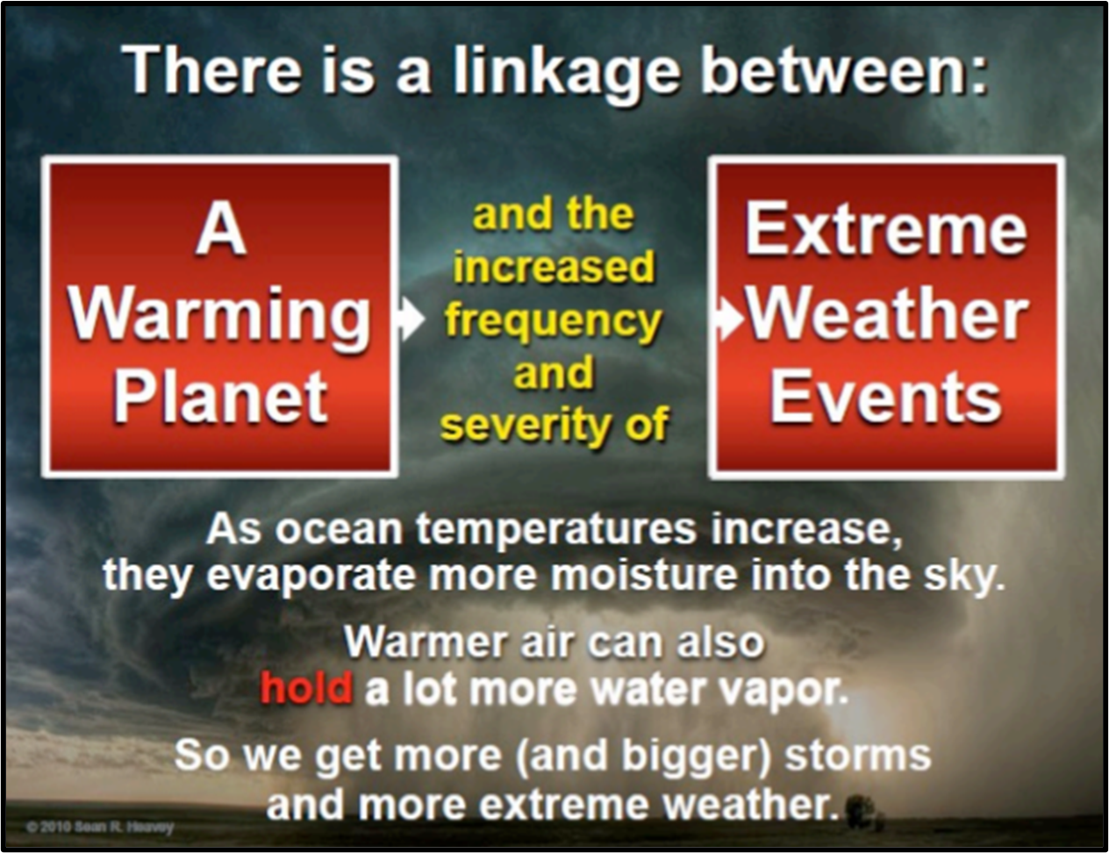

Slide 26
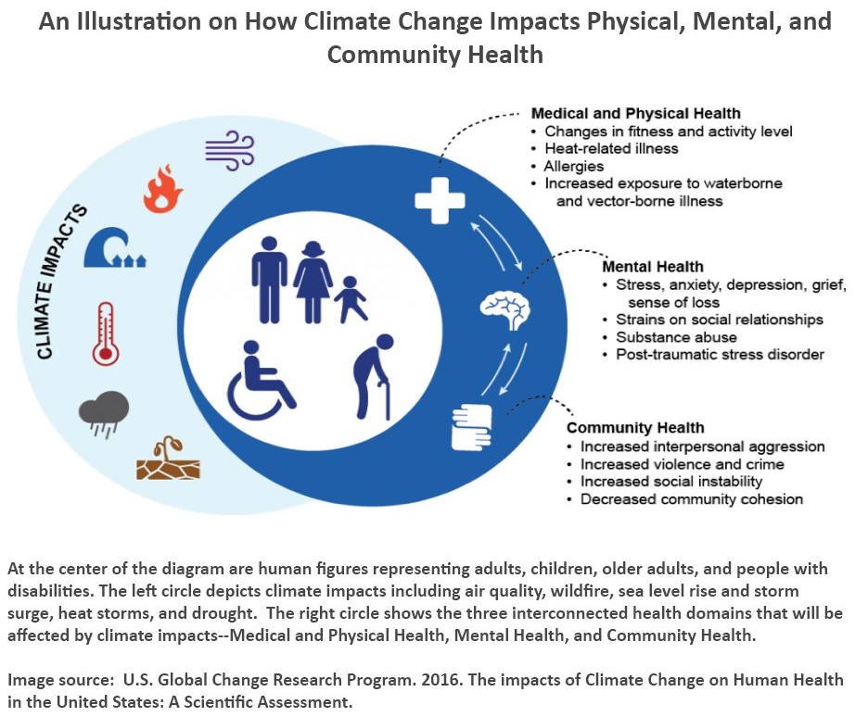

Slide 27
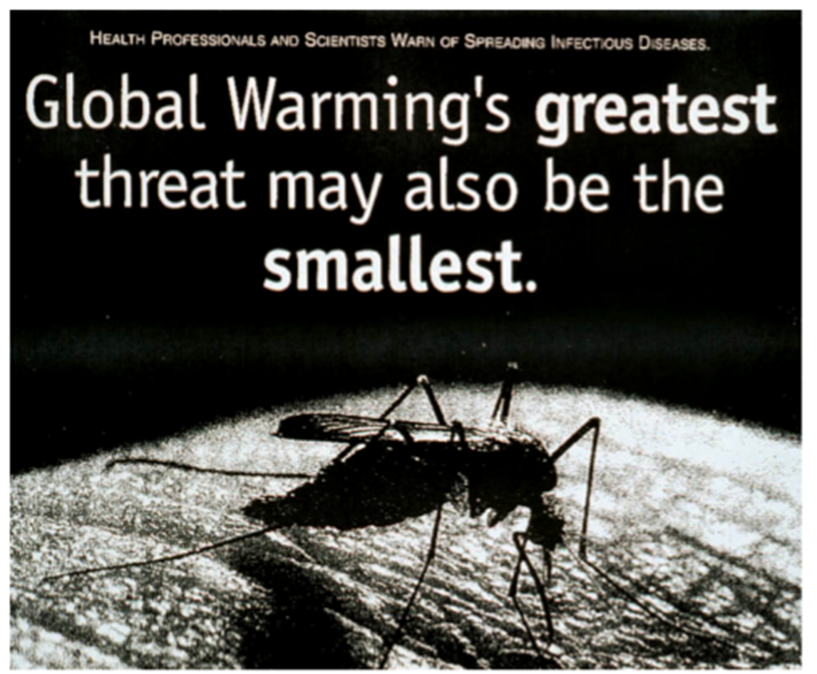

Slide 28
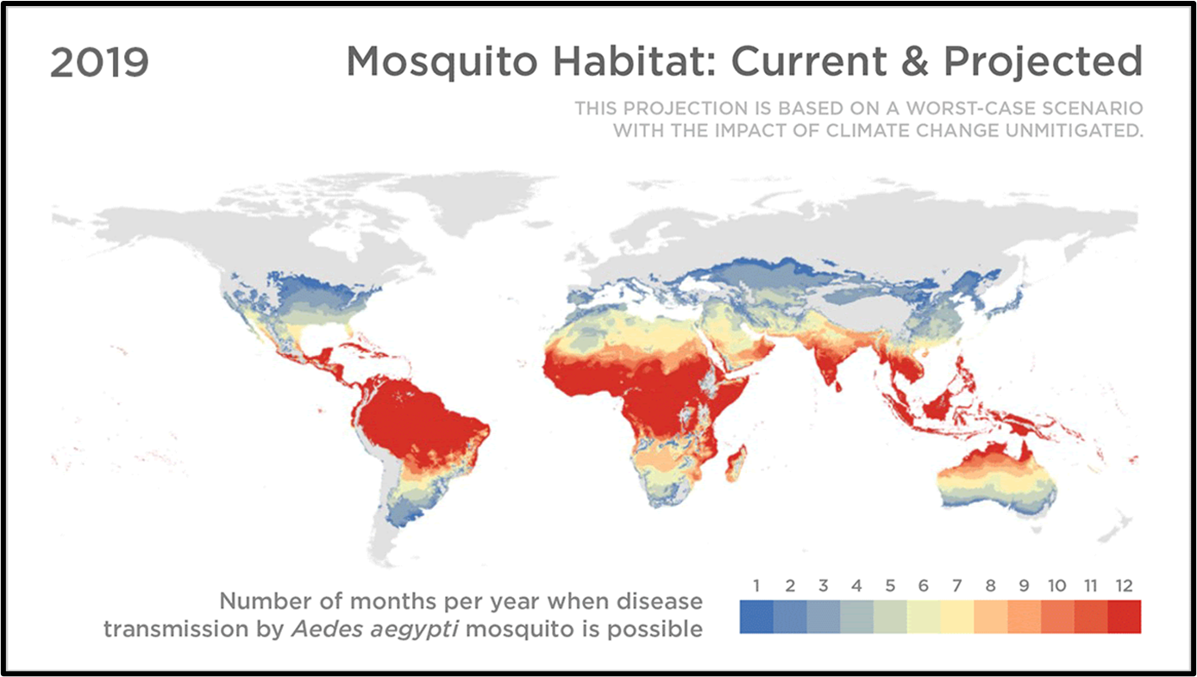

Slide 29
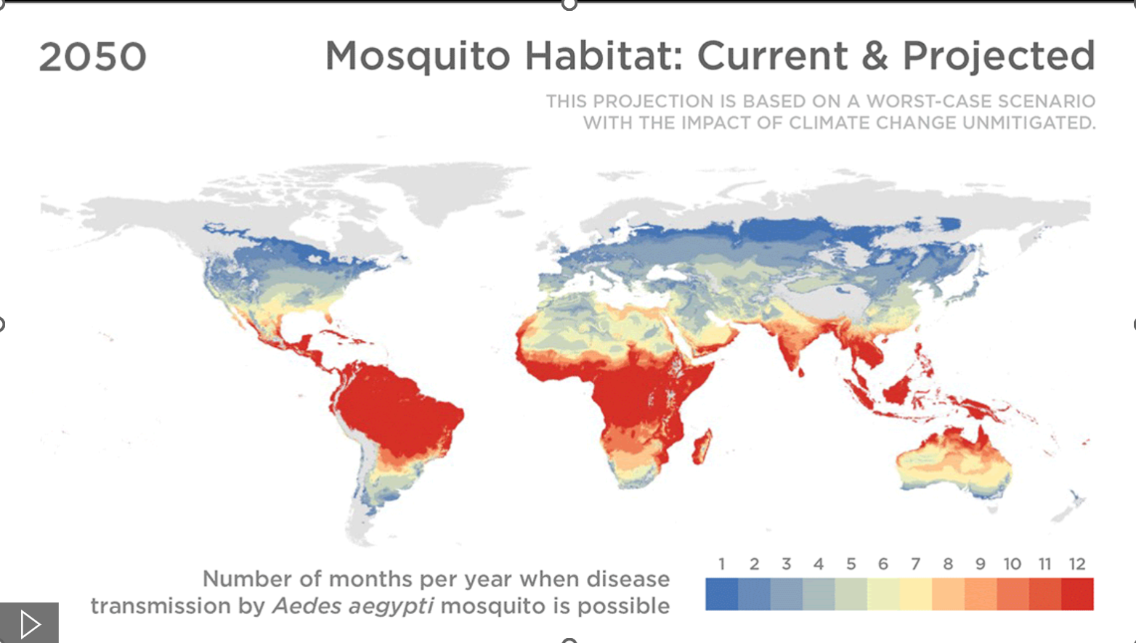

Slide 30
Vector-Borne Disease
Vector-borne disease cases tripled in the US from 2004 to 2016.
About 80% of vector control organizations lack critical prevention and control capabilities.
Malaria Dengue Lyme Disease West Nile VIrus Schistosomiasis Leishmaniasis | Chagas Disease Yellow Fever Zika Eastern Equine Encephalitis Chikungunya

Slide 31
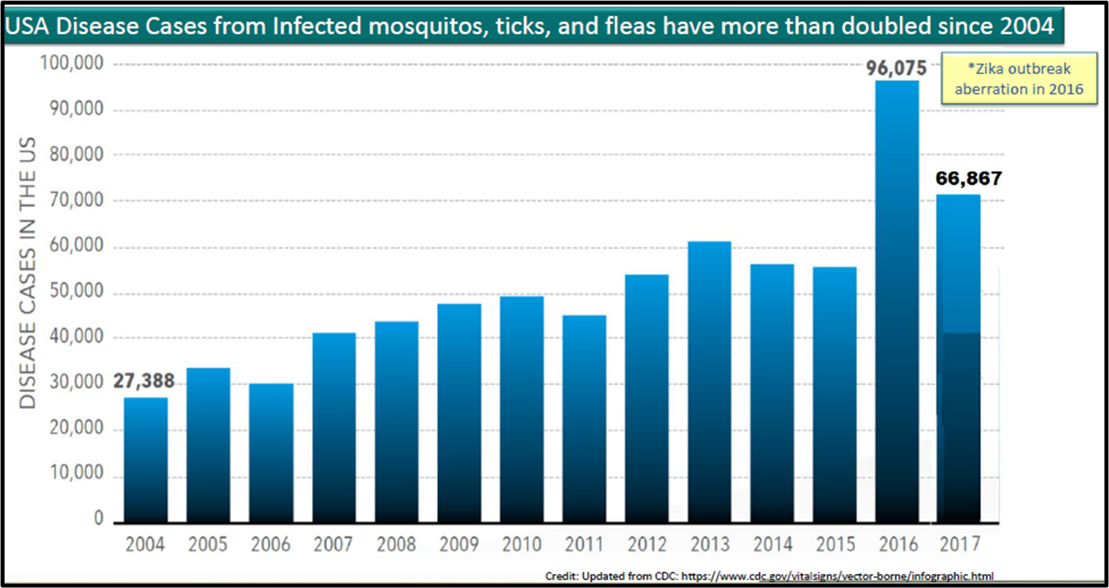

Slide 32
Poll Question
Are you currently addressing the health impacts of climate change through an MLP?
Yes
No - I have an MLP, but we are not directly addressing climate change
No - I do not currently have an MLP

Slide 33

Thank you!

Slide 34



Protecting Climate-Vulnerable Patients via Advocacy Templates
IN HOUSING
IN EDUCATION
IN EMPLOYMENT

Slide 35
Advocacy Templates
Document template to effectively assert and protect the legal rights of individual patients/families
Can be easily accessed by health care staff and personalized on behalf of a patient
Expand the capacity of an MLP to reach more patients
Show nexus between requested accommodation/modification and health condition
Create a paper trail and evidence that may come in handy at a later date
DO NOT require the patient to be receiving/eligible for SSA disability
Should be drafted in conjunction with legal provider
Goal: To have templates as part of EHR and providers empowered to use them

Slide 36
Reasonable Accommodations and Modifications in Housing
Fair Housing Act protects against discrimination on the basis of race, color, national origin, religion, sex (including gender identity and sexual orientation), familial status, or disability
A disabled person is defined as :
  A person with a physical or mental impairment that substantially limits one or more major life activities; or
  A person with a record of such an impairment; or
  A person who is not disabled but is regarded as disabled.
Accommodations: Changes to rules or services
Modifications: Changes to the physical building

Slide 37
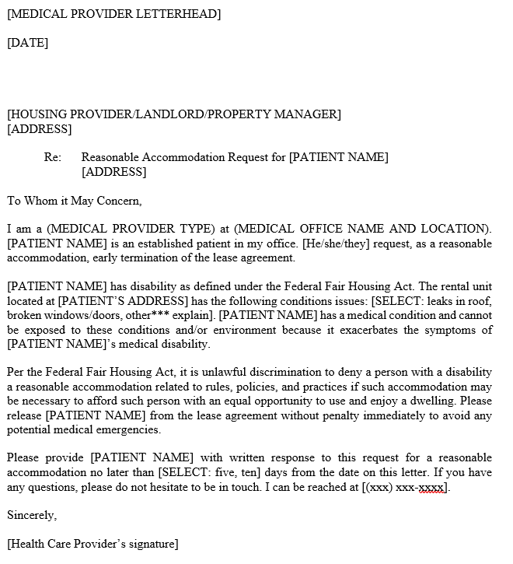
Accommodation:
Early Termination of Lease Agreement

Slide 38
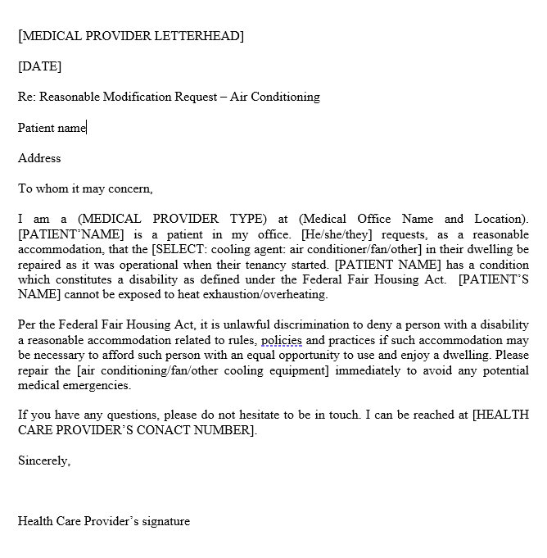
Modification:
Repair Air Conditioning

Slide 39
Reasonable Accommodations in Education
All children in grades K-12 are entitled to a free, appropriate public education.
Section 504 of the Rehabilitation Act of 1973 gives students who have a physical or mental impairment accommodations to “even the playing field.”
Applies to all school-related events: instructional time, extracurriculars, fields trips
Impairment defined as substantially limiting one or more major life activities.
Accommodations:
  Additional water breaks on class field trip
  Access to shade at recess

Slide 40
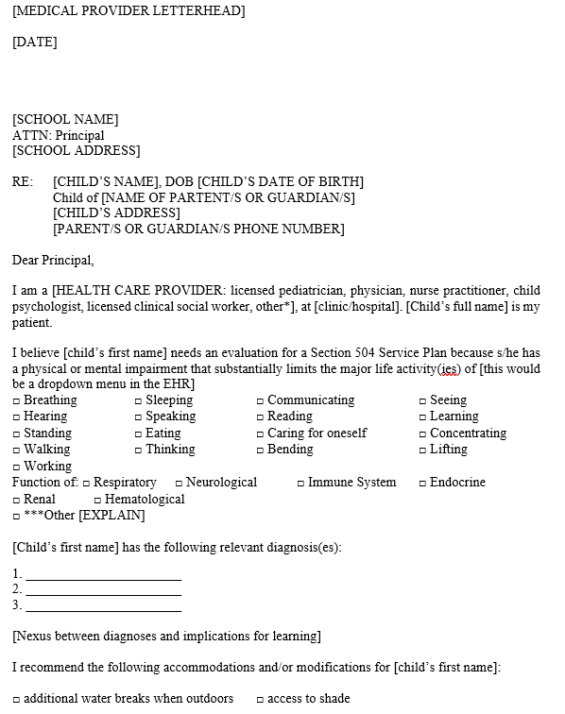
Reasonable Accommodation in Education

Slide 41
Reasonable Accommodations in Employment
The Americans with Disabilities Act (ADA) mandates reasonable accommodations for disabled employees and prohibits employers from retaliating against employees who request accommodations.
A reasonable accommodation is any change to the application or hiring process, to the job, to the way the job is done, or the work environment that allows a person with a disability who is qualified for the job to perform the essential functions of that job and enjoy equal employment opportunities.
Disability is defined as a physical or mental impairment that substantially limits one or more major life activities.

Slide 42
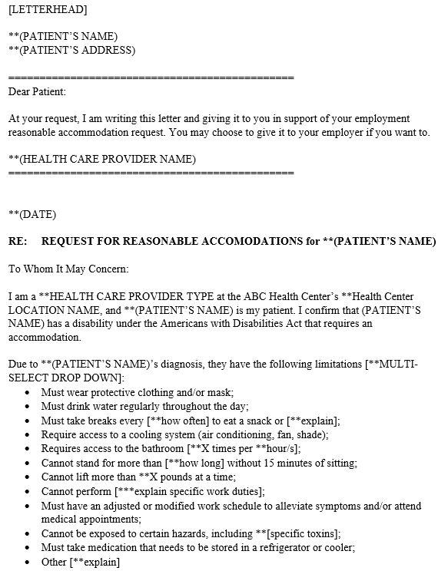
Reasonable Accommodation in Employment

Slide 43
Resources
Medical Society Consortium On Climate And Health www.medsocietiesforclimatehealth.org
Florida Clinicians For Climate Action www.floridaclinicians.org
Miami Dade County Extreme Heat Toolkit https://miamifoundation.org/wp-content/uploads/2021/10/extreme-heat-toolkit.pdf
Public Health Institute’s Center For Climate Change And Health • A Framework For Action https://www.phi.org/thought-leadership/climate-change-and-health-a-framework-for-action/

Slide 44
Thank you!
Christina Russo Walters
Senior Managing Attorney
Medical-Legal Partnerships
Community Legal Services Mid-Florida
clsmf.org
christinar@clsmf.org
Dr. Frederick Anderson
Associate Professor; Medical Director
Florida International University
Mobile Health Center
Office: 305-348-4840
fwanders@fiu.edu

Slide 45

Please submit questions using the Q&A function.
Moderated by:
Katie Hathaway, JD
National Center for Medical-Legal Partnership

Slide 46
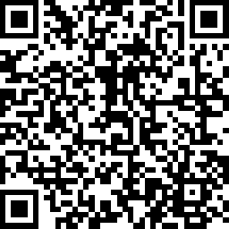
Thank you!
Please take a moment to complete our survey!
https://www.surveymonkey.com/r/PJ29JT8
A link to the survey is also in the chat.

Slide 47
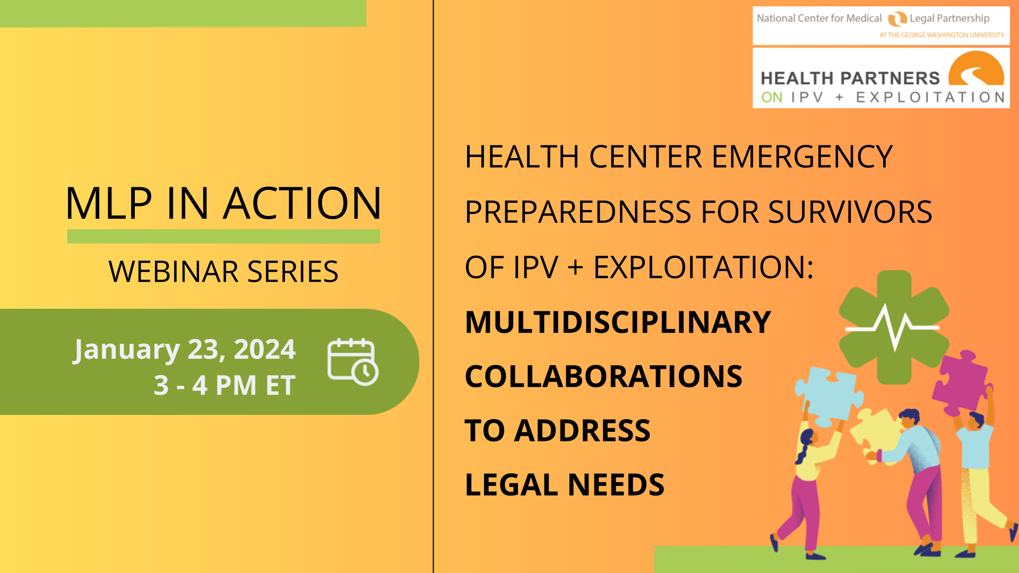


Happening Soon. RSVP Now!
Register here: https://medical-legalpartnership.org/learning-opportunities/

